Slide 1
Rose
Bud
Thorn
Activity
Scrutiny and Governance 2025
CfGS Annual Conference
2025
Created by delegates

Slide 2
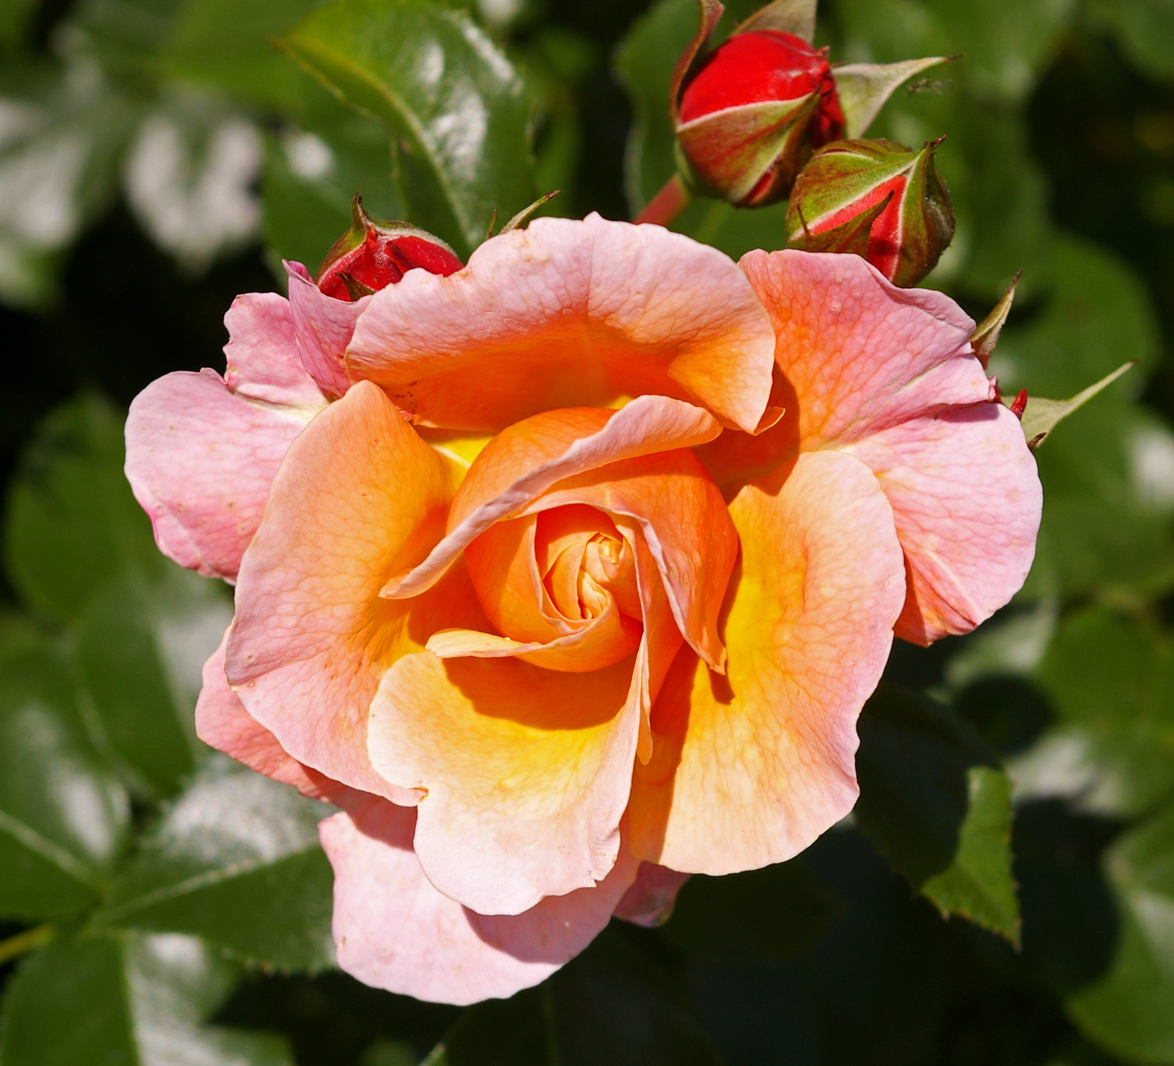
Rose – What’s working
The people
Relationships
A non- confrontational relationship between executive and opposition
Scrutiny when in intervention might be seen as a bad thing, but being one of the priorities of the commissioners, SLT and Cabinet is refreshing.
Fair and frank conversations.
More informal discussions.
Going out in the community.
Better planning – our committee have taken a step back, looked at the whole year and tried to link in better with the forward plan timing.
Change of processes.
Member engagement.
CfGS!
Deep dive research projects.
Hybrid engagement.
Creative thinking.
Good topics

Slide 3
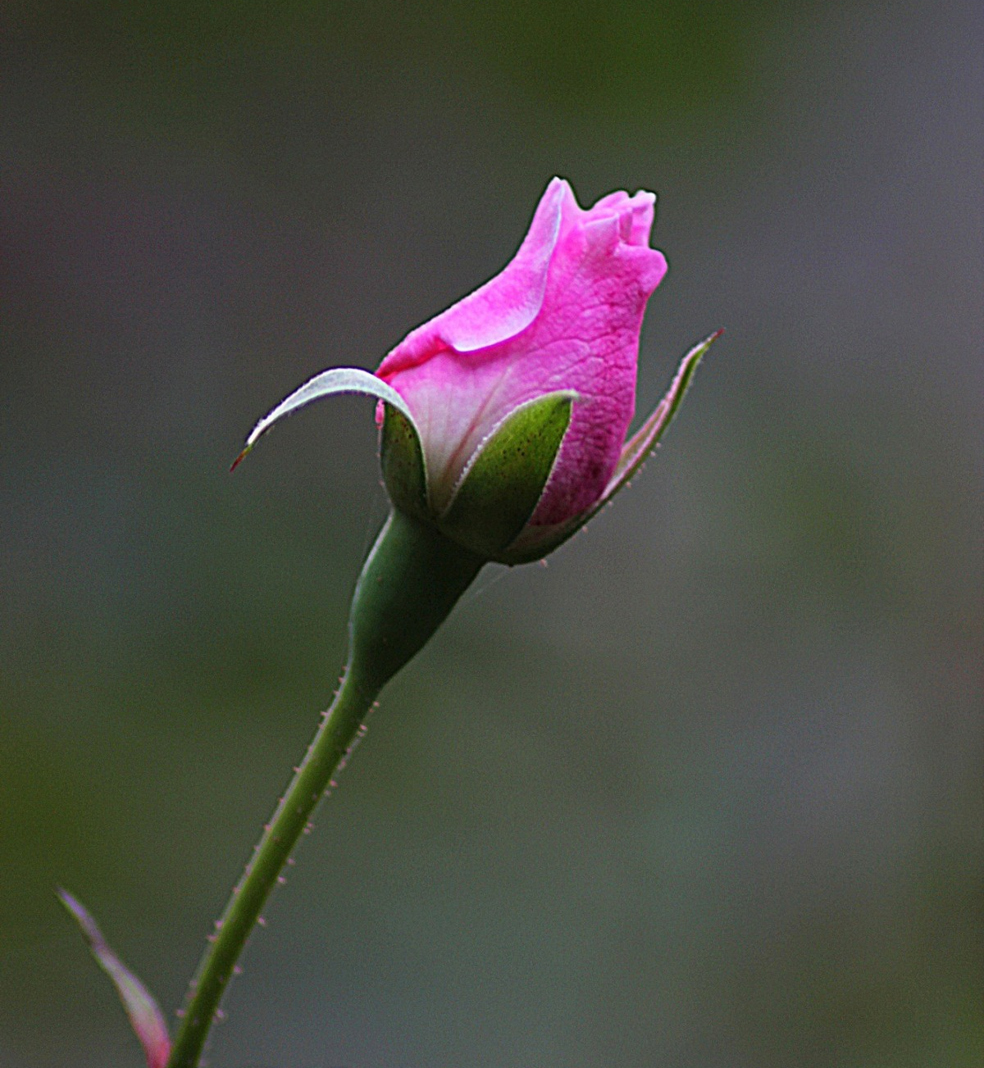
Bud – What’s emergent and shows promise
Local connections.
Strategic scrutiny.
More Democratic Services required.
LGR and the new unitary authorities.
Clearer relationships with audit.
Larger, better resourced authorities.
Strong Chair – not afraid to interject if Cllr questioning wander off or focuses on the wrong aspect.
Task and Finish Group ideas.
Scrutineers networking together.
Creative approaches.
Involving local universities/academics in work.
Relationship (trust) between officers and members

Slide 4
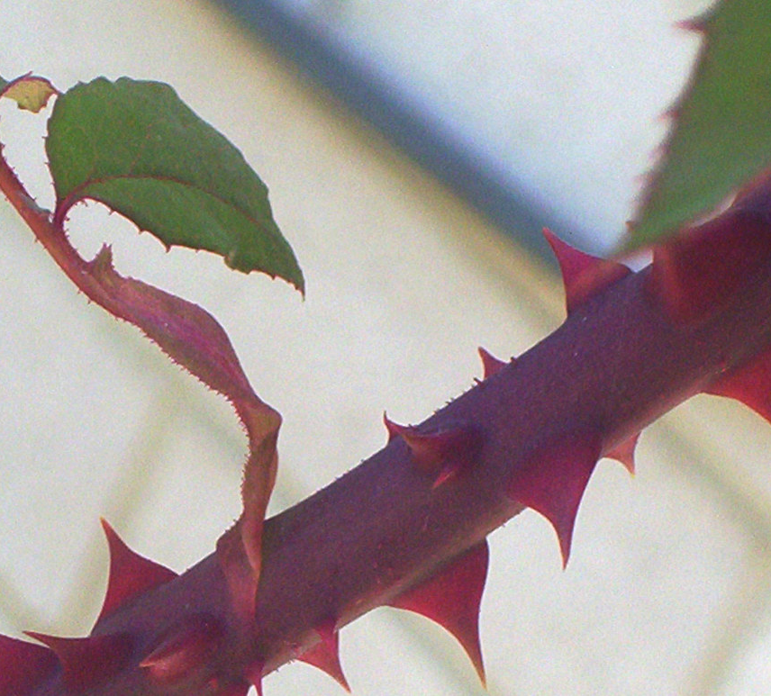
Thorn – What’s standing in the way
Culture.
Cabinet.
Directors.
Resources, time and apathetic members and officers.
A lack of dedicated officer resource.
Lack of resources, staffing in scrutiny.
The MO, CEO and Leader.
Party politics.
Negative, aggressive opposition.
Members.
Lack of knowledge.
The focus on formal committee meetings.
Senior officer engagement.
The feeling that officers think scrutiny are ‘picking’ when mostly they genuinely want to understand.
Short term political point scoring. (NB. Politics as such cannot be a blocker otherwise the system is wrong.)
Political ambition, attendance, energy.
Wider engagement of officials and staff.

