Slide 1

2017 Edelman
Trust Barometer
1

Slide 2
2017 Edelman Trust Barometer Methodology
Online Survey in
28 Countries
General Online Population
Informed
Public
Mass
Population
17 years of data
33,000+ respondents total
Initial fieldwork was conducted between October 13th and November 16th, 2016
6 years in 25+ markets
Ages 18+
1,150 respondents
per country
All slides show General Online Population unless otherwise noted
9 years in 20+ markets
Represents 13% of total global population
500 respondents in U.S. and China; 200 in all other countries
Must meet 4 criteria:
  Ages 25-64
  College educated
  In top 25% of household income per age group in each country
  Report significant media consumption and engagement in business news
All population not including
Informed Public
Represents 87% of total
global population
JAN
January Supplement, UK
1,150 General Online Population respondents, with additional boosts of 250 Low Income Household respondents and 100 High Net Worth individuals
Fieldwork was conducted between 23 December, 2016 and 7 January, 2017

Slide 3
Trust in Retrospect
2001
2002
2003
2004
2005
2006
2007
2008
2009
Rising Influence of NGOs
Fall of the Celebrity CEO
Earned Media More Credible Than Advertising
U.S. Companies in Europe Suffer Trust Discount
Trust Shifts from “Authorities” to Peers
“A Person Like Me” Emerges as Credible Spokesperson
Business More Trusted Than Government
and Media
Young Influencers Have More Trust in Business
Business Must Partner with Government to Regain Trust
2010
2011
2012
2013
2014
2015
2016
2017
Trust is Now an Essential Line
of Business
Rise of
Authority
Figures
Fall of Government
Crisis of Leadership
Business to
Lead the Debate for Change
Trust is
Essential to Innovation
Growing Inequality of Trust
Trust
in Crisis
Notes:
12/16: UPDATED WITH RWE’S ESSAY TOPIC BY SA
Updated BUT may need to revisit.

Slide 4



2017: Trust Gap Widens
Percent trust in the four institutions of government,
business, media and NGOs, 2012 to 2017
Informed
Public
Largest Gaps
21 pts
19 pts
18 pts
12^{pt}
Gap
15^{pt}
Gap
A 3-point increase in
the last year
9^{pt}
Gap
Mass
Population
Notes:
12/16: CHECKED BY SA USING TABLES

Slide 5
Trust Index
Mass Population
Left Behind
Informed
Public
Mass
Population
60 |  | Global
80 |  | India
79 |  | China
78 |  | Indonesia
77 |  | UAE
71 |  | Singapore
68 |  | U.S.
62 |  | Canada
62 |  | Netherlands
61 |  | Italy
61 |  | Mexico
57 |  | Malaysia
57 |  | Spain
56 |  | France
56 |  | U.K.
55 |  | Colombia
54 |  | Australia
54 |  | Germany
53 |  | Hong Kong
51 |  | Argentina
51 |  | Brazil
50 |  | S. Korea
50 |  | Turkey
49 |  | Japan
49 |  | S. Africa
47 |  | Sweden
45 |  | Russia
44 |  | Ireland
43 |  | Poland
45 |  | Global
70 |  | India
67 |  | Indonesia
62 |  | China
59 |  | Singapore
59 |  | UAE
52 |  | Netherlands
50 |  | Colombia
50 |  | Mexico
47 |  | Brazil
47 |  | Canada
47 |  | Italy
47 |  | Malaysia
47 |  | U.S.
45 |  | Argentina
42 |  | Hong Kong
41 |  | S. Africa
41 |  | Spain
41 |  | Turkey
40 |  | Australia
39 |  | Germany
38 |  | France
37 |  | U.K.
36 |  | S. Korea
36 |  | Sweden
35 |  | Ireland
34 |  | Japan
34 |  | Poland
31 |  | Russia
Average trust in institutions,
Informed Public vs. Mass Population
Trusters
(60-100)
Neutrals
(50-59)
Distrusters
(1-49)
Source: 2017 Edelman Trust Barometer.
The Trust Index is an average of a country’s trust in the institutions of government, business, media and NGOs. Informed Public and Mass Population, 28-country global total.
The Mass Population distrusts
their institutions in
20 of 28 countries
Notes:
1/8/17: CHECKED BY SA USING TABLES; UPDATED THE TIE SCORES TO BE IN ALPHABETICAL ORDER BASED ON COUNTRY NAME; UPDATED NUMBER OF DISTRUSTER COUNTRIES FOR MASS IN CALL OUT, FROM 25 TO 20 (THE 25 WAS INCLUDED NEUTRALS WHICH I FEEL IS INACCURATE

Slide 6
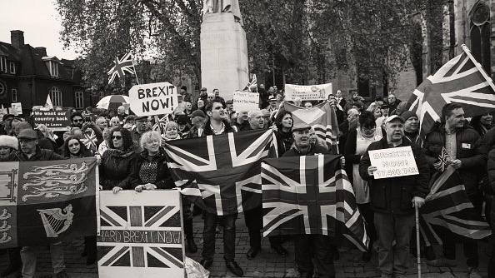

Trust
in Crisis
Notes:
Slide Notes: In today’s atmosphere of distrust, the unvirtuous, self-reinforcing cycle of societal fears interacting with a system that is highly suspect is reinforced and amplified by the radical changes in our media ecosystem, the long-term impact of which are as yet little-understood.

Slide 7
Trust Index
A World of Distrust
2016
2017
50 |  | Global
73 |  | China
66 |  | UAE
65 |  | India
64 |  | Singapore
62 |  | Indonesia
60 |  | Mexico
56 |  | Canada
55 |  | Colombia
52 |  | Netherlands
51 |  | Argentina
51 |  | Malaysia
50 |  | Brazil
49 |  | Australia
49 |  | Italy
49 |  | U.S.
47 |  | Hong Kong
46 |  | Spain
45 |  | S. Africa
42 |  | Germany
42 |  | S. Korea
42 |  | U.K.
41 |  | France
41 |  | Ireland
41 |  | Turkey
39 |  | Russia
38 |  | Japan
37 |  | Sweden
35 |  | Poland
47 |  | Global
72 |  | India
69 |  | Indonesia
67 |  | China
60 |  | Singapore
60 |  | UAE
53 |  | Netherlands
52 |  | Mexico
52 |  | U.S.
50 |  | Colombia
49 |  | Canada
48 |  | Brazil
48 |  | Italy
48 |  | Malaysia
45 |  | Argentina
44 |  | Hong Kong
44 |  | Spain
43 |  | Turkey
42 |  | Australia
42 |  | S. Africa
41 |  | Germany
40 |  | France
40 |  | U.K.
38 |  | S. Korea
37 |  | Sweden
36 |  | Ireland
35 |  | Japan
35 |  | Poland
34 |  | Russia
3-point decrease
in the global
Trust Index
Trust declines in 21
of 28 countries—the broadest declines since beginning General Population tracking in 2012
2 in 3 countries are now distrusters
Average trust in institutions,
2016 vs. 2017
Trusters
(60-100)
Neutrals
(50-59)
Distrusters
(1-49)
Notes:
12/16: CHECKED BY SA USING ANNOTATED
1/5/17: CHECKED BY SA USING ANNOTATED

Slide 8

Evaporation of Trust in Past Year in the UK
JAN
Percent trust in institutions, 2012-2017
Trust Index:
35 | 43 | 42 | 39 | 42 | 40 | 29
Notes:
1/5/17: CHECKED BY SA USING ANNOTATED; CALLOUTS CHECKED

Slide 9
All Four Institutions Distrusted in UK
2016
2017
Percent trust in the four institutions of government, business, media and NGOs, 2016 vs. 2017
JAN UK Supplement
Trusted
Neutral
50%
Distrusted
-14
-12
-8
-10
NGOs
Business
Media
Government
Notes:
12/16: CHECKED BY SA USING ANNOTATED
Slide Notes: Globally, we have never before reported declines in all 4 institutions.
2 of them are now distrusted,
1/5/17: CHECKED BY SA USING ANNOTATED

Slide 10
Trust Crisis Deepens Amongst Low Income Households And Hits High Net Worth For First Time
JAN
Low Income Households
General Population
High Net Worth
Percent trust in the four institutions of government, business, media and NGOs
2016
2017
NGOs
Business
Media
Government
NGOs
Business
Media
Government

Slide 11
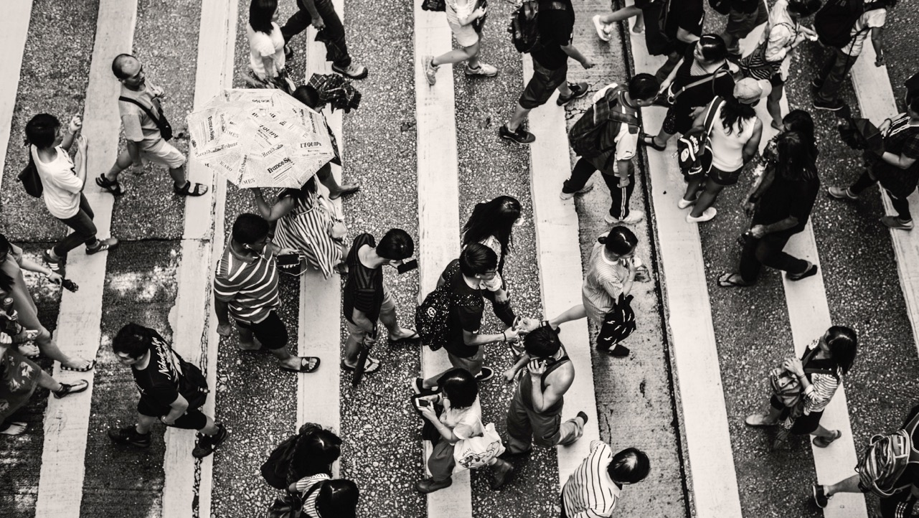
Post Brexit

Slide 12
If We Ran the Referendum Again, People Think We’d Get a Different Outcome. We Would Not.
JAN
General Population
Informed Public
Percent who voted for the UK to leave/remain in the European Union
Mass Population
87% of those who voted to leave, and
88%of those who voted to remain
Are sure of their decision six months after the vote
Leave
Remain

Slide 13
Even High Net Worth Split Over Brexit Vote
JAN
Low Income Households
Percent who voted for the UK to leave/remain in the European Union
General Population
High Net Worth
Leave
Remain

Slide 14
Post Brexit Broad Agreement That We Should Just Get On With It
JAN
Low Income Households
General Population
Percent who agree with the following statements
High Net Worth

Slide 15
Post Brexit, 6 in 10 Are Not Worried About The Future
JAN
Low Income Households
Attitude toward the future following the UK decision to leave the European Union
General Population
High Net Worth

Slide 16
General Population Unclear on the Impact of Brexit
JAN
Negative
Neutral
Perceived impact of the UK’s withdrawal from the EU
Positive

Slide 17
Theresa May and the Three Brexiteers Not Trusted to Deliver Brexit
JAN
General Population
Informed Public
Percent trust political figures to do what is right as regards the UK’s withdrawal from the EU, 2017
Mass Population
Trusted
Neutral
50%
Distrusted

Slide 18
Rejection of UK Political Institutions Post Brexit
JAN
Percent who trust institutions less over past year, 2017
Significant decline of trust in political system
50%

Slide 19
Post Brexit 8 In 10 Brits Do Not Trust Political Leaders to Do What Is Right
JAN
Distrust
Neutral
Trust
Percent trust in institutions, 2017
50%

Slide 20
Loss of Trust Amongst Parties Post Brexit
JAN
Trust in each political party to do what is right, 2014-2017
All Parties Distrusted
Six Months Post Brexit
 | Political Party | 2014 | 2015 | 2016 | 2017
 | Conservatives | 37% | 36% | 38% | 28%
 | Labour | 41% | 36% | 31% | 25%
 | Liberal Democrats | 31% | 25% | 23% | 20%
 | UKIP | 29% | 27% | 19% | 19%
 | Green Party | 38% | 36% | 29% | 27%
 | Scottish National Party | 23% | 20% | 22% | 19%
 | Plaid Cymru | 22% | 15% | 16% | 16%

Slide 21
Loss of Faith in all Political Leaders Following Brexit
JAN
Trust in each political leader to do what is right, 2014-2017
 | Political Leader | 2014 | 2015 | 2016 | 2017
 | David Cameron | 33% | 34% | 40% | 23%
 | Boris Johnson | 43% | 39% | 37% | 24%
 | Jeremy Corbyn | N/A | N/A | 28% | 23%
 | Tim Farron | N/A | N/A | 18% | 15%
 | Nigel Farage | 25% | 28% | 21% | 20%
 | Nicola Sturgeon | N/A | 20% | 28% | 23%
 | Leanne Wood | 11% | 14% | 16% | 11%
 | Theresa May | N/A | N/A | N/A | 35%
 | Sadiq Khan | N/A | N/A | N/A | 24%
All Politicians Distrusted
Six Months Post Brexit

Slide 22
Across the Board, British Political Leaders Distrusted
JAN
General Population
Informed Public
Trust in each political leader to do what is right, 2017
Mass Population
Trusted
Neutral
50%
Distrusted
Notes:
1/5/17: CHECKED BY SA USING ANNOTATED; CALLOUTS CHECKED

Slide 23
Honesty Seen as Unlikely from British Politicians
JAN
General Population
Informed Public
Trust in each political leader to communicate honestly, 2017
Mass Population
Trusted
Neutral
50%
Distrusted
Notes:
1/5/17: CHECKED BY SA USING ANNOTATED; CALLOUTS CHECKED

Slide 24
Trump Triggers Crisis of Trust in Post-Brexit Britain
JAN
Negative
Neutral
Perceived impact of the US election of Donald Trump
Positive

Slide 25

The System
Is Broken
Notes:
Image Notes: A retouched and gray-scale version of http://forward.com/opinion/326547/are-french-jews-succumbing-to-marine-le-pens-xenophobic-siren-song/
FAITH
The institutions of the government, the media, business and NGOs function together to form the bedrock of the societies in which we live and work.
When we lose trust in them, we risk also losing faith in the entire system.

Slide 26
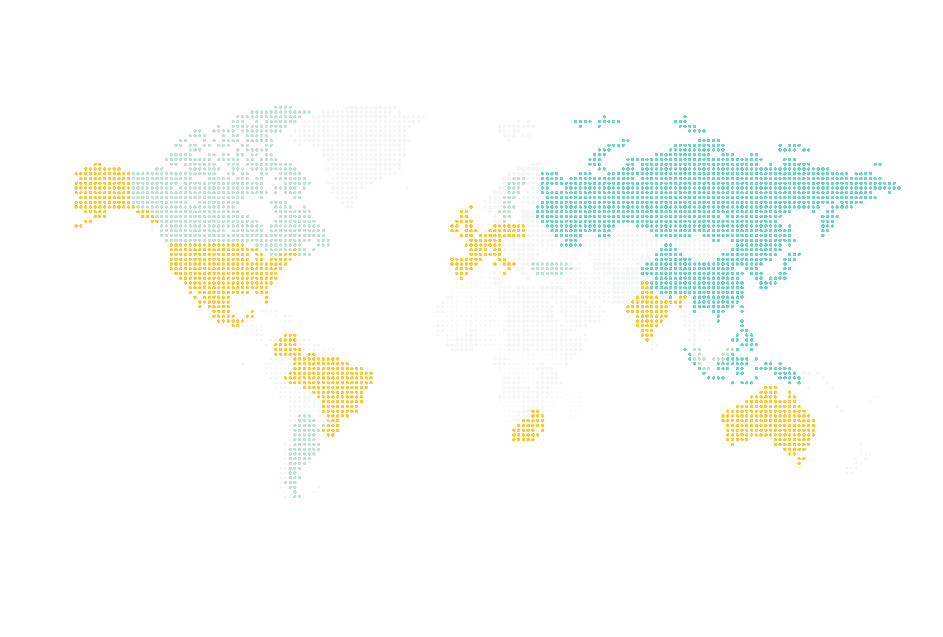
1 in 2 Countries Have Lost
Faith in the System
Systemic loss of faith restricted to Western-style democracies
Percent of population who believe
the system is not working
Above
global average
Aligned with
global average
Below
global average
In 14 countries, the percent of population that has lost faith is above the global average
 | Global | France | Italy | Mexico | S. Africa | Spain | Poland | Brazil | Colombia | Germany | U.K. | Australia | Ireland | U.S. | Netherlands | Canada | Sweden | Argentina | Malaysia | Turkey | Russia | S. Korea | Indonesia | Japan | India | Hong Kong | Singapore | China | UAE
System failing | 53 | 72 | 72 | 67 | 67 | 67 | 64 | 62 | 62 | 62 | 60 | 59 | 59 | 57 | 56 | 55 | 55 | 53 | 52 | 51 | 48 | 48 | 42 | 42 | 36 | 35 | 30 | 23 | 19
Uncertain | 32 | 22 | 24 | 25 | 24 | 25 | 25 | 25 | 27 | 26 | 29 | 30 | 26 | 33 | 33 | 30 | 29 | 29 | 37 | 31 | 28 | 41 | 40 | 45 | 45 | 50 | 43 | 47 | 40
Notes:
Data checked and updated by Cody. Used SR to check on 12/9.
CA: Updated with new populism numbers run out of SR on 12/13.
12/16: CHECKED BY SA WITH DATA FROM SURVEY REPORTER
SLIDE NOTES: So far we have looked only at global averages. Drilling down at a country level, you see that there are 14 countries where the sense that the system is not working has become the prevailing sentiment among the general population. Note that this sentiment is specific to western-style democracies, with the most intense levels in Western Europe, Latin America, and the Anglo-Saxon countries.

Slide 27
Majority in the UK Believe the System is Failing Them
Barely 1 in 10 believe the system is working for them
System failing
System working
Approximately
3 in 10 are uncertain
9 | 8 | 7 | 6 | 5 | 4 | 3 | 2 | 1
Completely true
Not at all true

Slide 28

Globally Even The Informed Believe the System Is Not Working
High-Income | College-Educated | Well-Informed
Top quartile of income | College degree or higher | Follow business and public policy information several times a week or more
48% | 49% | 51%
18

Slide 29
UK Amongst Countries with Above Average Belief the System Is Failing
Above-Average Level of Fear
Above-Average Belief the
System is Failing
Countries with Multiple
Fears and Failing System
Corruption
Immigration
Globalization
Eroding social values
Pace of change
% Who Agree System is Failing | 53 |  | 72 | 72 | 67 | 67 | 67 | 64 | 62 | 62 | 62 | 60 | 59 | 59 | 57 | 56 | 55 | 55 | 53 | 52 | 51 | 48 | 48 | 42 | 42 | 36 | 35 | 30 | 23 | 19
 | Global |  | France | Italy | Mexico | S. Africa | Spain | Poland | Brazil | Colombia | Germany | U.K. | Australia | Ireland | U.S. | Netherlands | Canada | Sweden | Argentina | Malaysia | Turkey | Russia | S. Korea | Indonesia | Japan | India | Hong Kong | Singapore | China | UAE
10 countries with above-average belief the system
is failing and multiple fears
4 countries with above-average belief the system is failing – but lack multiple fears

Slide 30
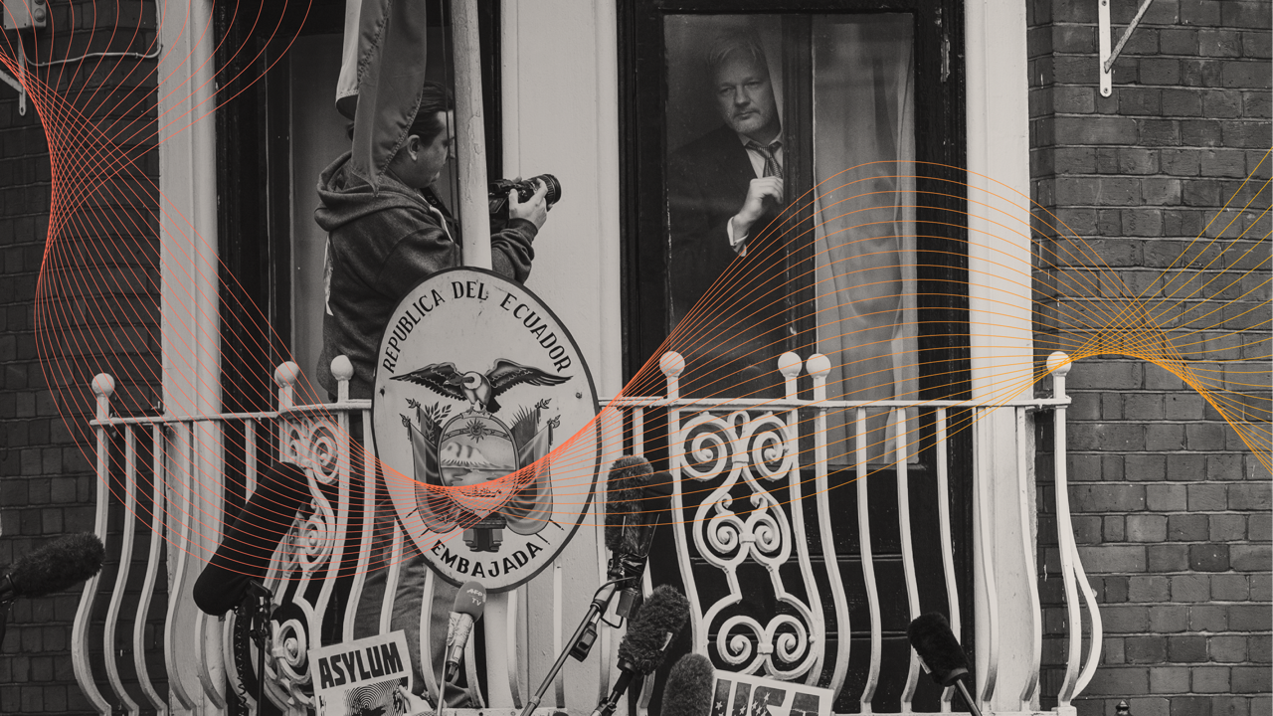
The Echo
Chamber
Notes:
Trust in institutions is literally evaporating… So what do this year’s results tell us about the state of trust in 2016?
(Image Source: A cropped and gray-scaled retouch of Wikipedia https://upload.wikimedia.org/wikipedia/commons/2/27/Capitol_Building_Full_View.jpg)

Slide 31

The Echo Chamber in Action
Facts matter less
Bias is the filter
Humans not required
Nearly
4x more likely
to ignore information that supports a position they do not believe in
Nearly
More likely
to believe
2 in 5 agree
“I would support politicians I trust to make things better for me and my family
even if they exaggerated the truth”
52%
Do not regularly listen to people or organisations with whom they often disagree
59%
Search
Engines
41%
Human
Editors

Slide 32
Globally Traditional Media Shows Steepest Decline
Percent trust in each source for general news and information
 |  | 2012 | 2017
 | Search engines* | 61 | 64
 | Traditional media | 62 | 57
 | Online-only media** | 46 | 51
 | Owned media | 41 | 43
 | Social media | 44 | 41
 | Media as an institution | 46 | 43
Change, 2012 - 2017
+3
-5
+5
+2
-3
-3
Traditional media down 5 points
Owned media now as trusted as media as an institution
43
43

Slide 33

In the UK Official Sources Are Distrusted
Percent who find each source more believable than its pair
73%
Individuals
66%
Reformer
76%
Leaked Information
27%
Institutions
34%
Preserver of
Status Quo
24%
Company Press
Statements

Slide 34
Desire for Trustworthy Information Amidst Questionable Media Ethics
JAN
Percent agreement with each statement, 2016 vs. 2017

Slide 35

Business
on Notice
Notes:
Image Notes: A retouched and gray-scale version of http://forward.com/opinion/326547/are-french-jews-succumbing-to-marine-le-pens-xenophobic-siren-song/
FAITH
The institutions of the government, the media, business and NGOs function together to form the bedrock of the societies in which we live and work.
When we lose trust in them, we risk also losing faith in the entire system.

Slide 36

Business Expected to Lead
73% agree
“A company can take specific actions that both increase
profits and improve the economic and social conditions in the community where it operates.”
Notes:
CA: Checked on 12/16 using the annotated. Updated footer.
Images
http://www.vishwagujarat.com/international/british-pm-faces-pressure-over-sugar-tax/
http://www.post-gazette.com/opinion/2016/10/06/In-defense-of-Heather-Bresch/stories/201610060014
1/5/17: CHECKED BY SA USING ANNOTATED

Slide 37
All-time Low for CEO Credibility
Distrust
Neutral
Trust
Percent rate CEOs as extremely/very credible, 2016 vs. 2017
−
+
Y-to-Y Change
CEOs not credible in 23 countries
Declines in all 28 countries
50%
-12
-7
-9
-12
-11
-12
-13
-19
-16
-7
-10
-10
-12
-11
-15
-14
-5
-16
-10
-17
-12
-13
-18
-16
-6
-16
-12
-15
-8

Slide 38
Experts Retain Position of Credibility
Percent who rate each spokesperson as extremely/very credible, and change from 2016 to 2017
−
+
Y-to-Y Change
A person like yourself amongst most credible spokespeople
CEO credibility decreased the
most, dropping to an all-time low
Unlike the global trend, experts remain more trusted than “a person like yourself”
-6
-7
-3
-5
-9
-7
-8
-12
-8
-7
-5
Notes:
CA: Checked on 12/16 using the annotated. Added YOY comparison to sub-title. Added gaps because we had some that weren’t callout out. Updated gap for ‘financial industry analyst’. Updated footer.
SA: Checked on 1/10/17 using annotated
SLIDE NOTES: For the first time ever, “a person like yourself” is as credible as a technical or academic expert.
When institutions are not trusted, neither are their leaders. Boards of directors, government officials, NGO representatives, financial industry analysts—none of these are credible sources anymore.
Credibility of CEOs is at an all-time low, with a 12-point decline in the last year.

Slide 39
Business Plays a Role in Stoking Societal Fears
UK population worries about
losing their jobs due to:
52% the pace of change
in business and industry is too fast
54% globalization
is taking us in the wrong direction
Notes:
CA: Checked on 1/10/17 using annotated

Slide 40
What’s at Stake for Business?
69% agree
71% agree
“We need to prioritise the interests of our country over those of the rest of the world.”
“The government should protect our jobs and local industries, even if it means that our economy grows more slowly.”

Slide 41



Business’ License to Operate at Risk
78%
agree that the pharmaceutical
industry needs
more regulation
60%
agree that policymakers should
tax foods that negatively impact health
52%
do not agree that
financial market reforms have increased
economic stability
Regulation
Tax Policy
Reform

Slide 42

Talk With the People,
Not At the People
54%
Blunt and outspoken
48%
Company’s
social media
Which is more believable?
46%
Diplomatic
and polite
52%
Advertising
65%
Spontaneous
speaker
60%
Personal
experience
35%
Rehearsed
speaker
40%
Data

Slide 43
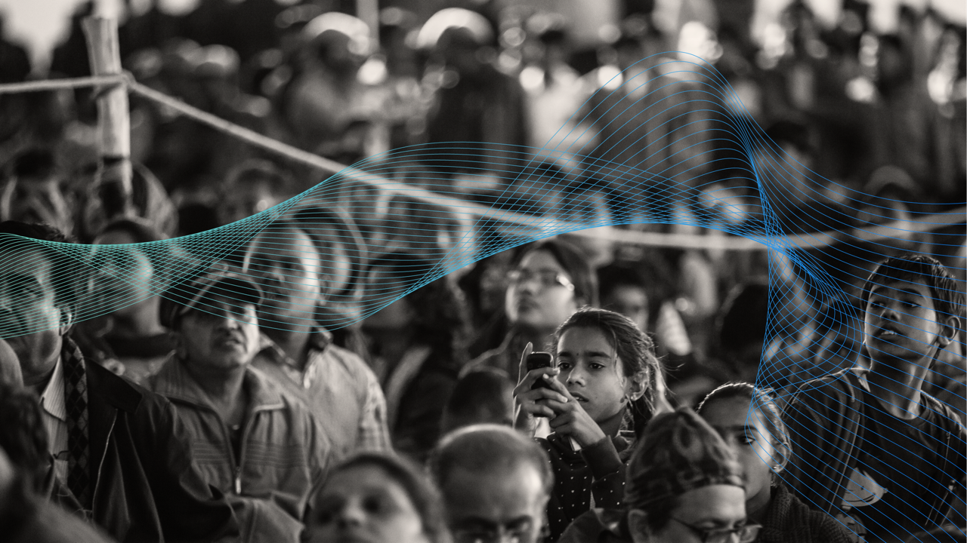
With the People,
Not For the People

Slide 44
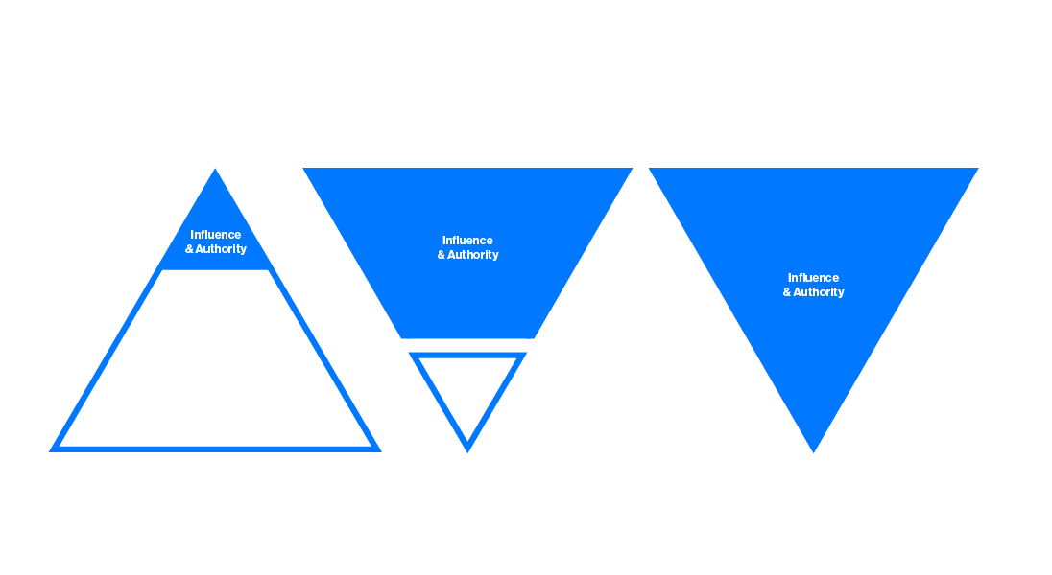
A Fundamental Shift
Old Model:
For the People
Current
Tension
New Model:
With the People
Elites manage institutions to do things “for” the people
Influence has shifted to the people; people using influence to reject established authority
Institutions working
with the people;
institutional silos dissolved
Notes:
Gone are the days if the traditional “pyramid of influence,” in which both authority and influence were concentrated in the hands of a small number of opinion shapers. This model was predicated on the belief that the informed publics have access to superior information, their interests were interconnected with those of the broader public and that becoming ‘an elite’ was open to all of those who work hard.
But today, due primarily to the democratization of information, we have seen the pyramid turned upside down. Influence now rests among the broad population, who talk to each other on social media or use search to access information, and no longer need to rely on the more “informed” population for ideas.
Influence is no longer automatically granted to those in authority.
And, as we have seen, the Mass Population’s view of the world—at a trust level of just 48—is vastly different from that of the 15% who have a trust level of 60, creating real challenge for those in authority who want to earn the ability to have broad influence.

